Slide 1
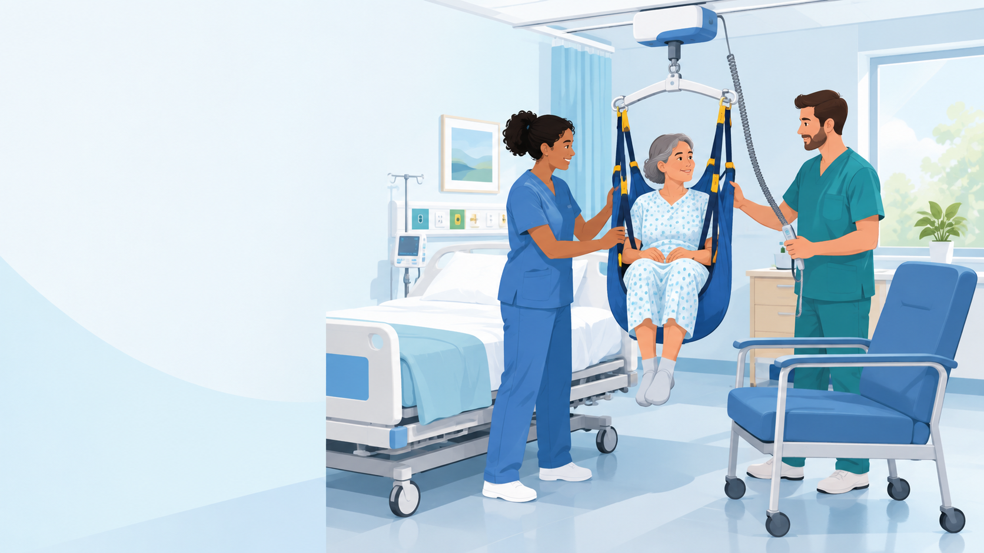
NEW NURSE ORIENTATION
Safe Patient Handling and Mobility
Protect yourself. Protect your patients.
Daniel Agbogidi, BSN, RN
Safe Patient Handling & Mobility Program Manager
VA Central California Health Care System
Notes:
Welcome to the nursing team. I'm Daniel Agbogidi, the Safe Patient Handling and Mobility (SPHM) Program Manager for VA Central California Health Care System.
This session covers:
- Why patient handling injures so many nurses
- How much weight you really move in a shift
- Which equipment to use for which patient
- The lifts you'll use here: the Sara 3000, the Maxi Sky 600 ceiling lift, the Denali 600 and the HoverMatt
- Your three habits: know your Unit Peer Leaders, use the equipment, ask for help

Slide 2
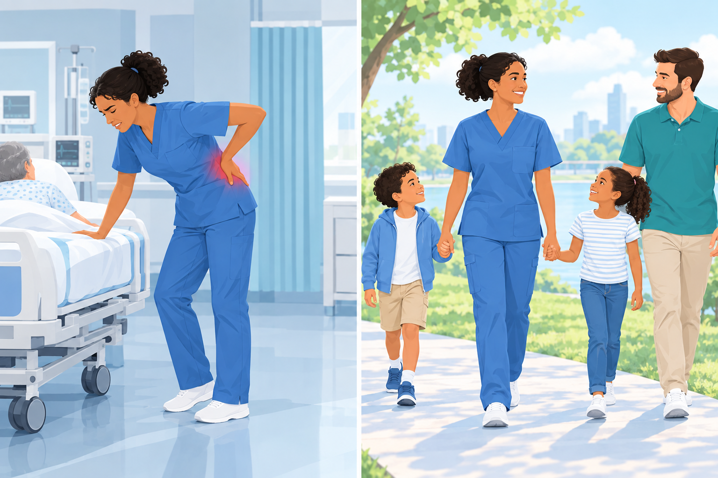
Did you know?
7×
the national average rate of musculoskeletal disorders among direct patient care workers
Lifting more than 35 lb of patient weight without assistive equipment puts you at risk for injury.
The equipment is here to protect you. Use it every time.
Notes:
Did you know? Direct patient care workers have about seven times the national average rate of musculoskeletal disorders.
The magic number to remember is 35 lb. Lifting more than 35 lb of patient weight without assistive equipment puts you at risk for injury. VHA Directive 1611 requires us to use SPHM technology above that limit, or whenever a task needs excessive force.

Slide 3
Disabling injuries
1
2
3
Career-ending
Every day, nurses suffer debilitating, often career-ending and life-altering injuries from repeatedly lifting and moving patients.
Lost time and disability
More than any other work-related injury or illness, musculoskeletal disorders cause lost work time, long medical care and permanent disability among health care workers.
Higher than firefighters
Nursing suffers more musculoskeletal injuries than any other profession, including firefighters, according to Bureau of Labor Statistics data.
Notes:
These injuries are not minor aches and pains.
- Every day, nurses suffer debilitating injuries from repeatedly lifting and moving patients. Many are career-ending and life-altering.
- More than any other work-related injury or illness, musculoskeletal disorders are responsible for lost work time, protracted medical care and permanent disability among health care workers.
- According to Bureau of Labor Statistics data, nursing suffers more musculoskeletal injuries than any other profession, including firefighters.

Slide 4
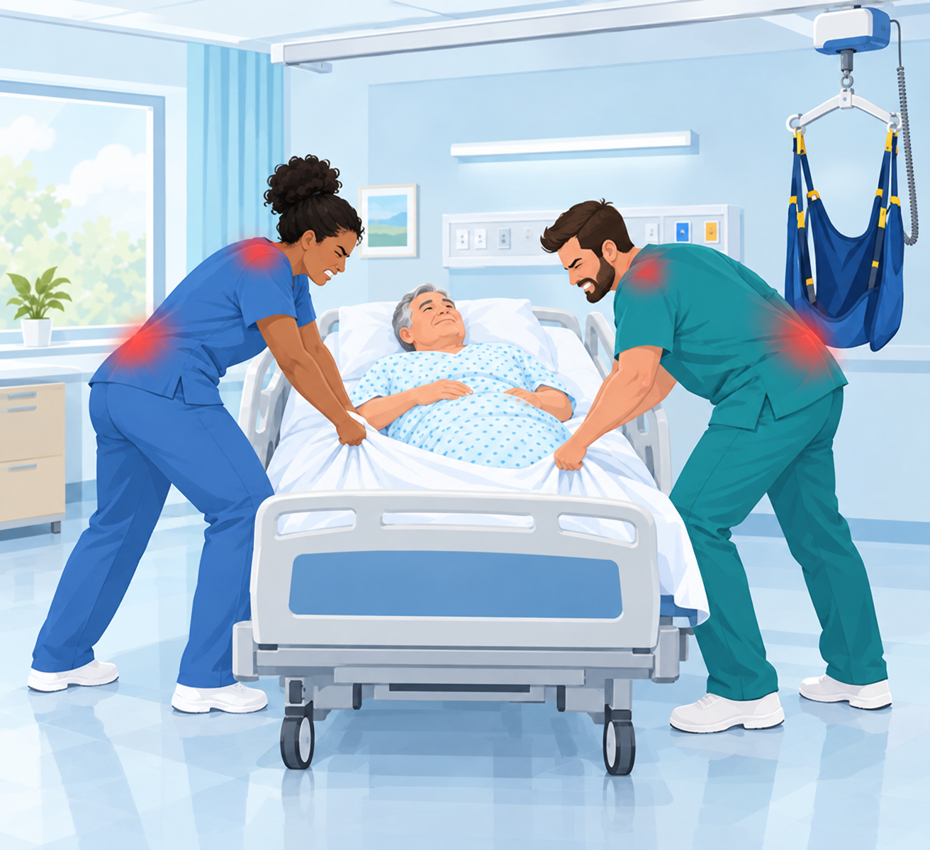
The tasks that injure us most
Repeated lifting and forceful movements during patient care lead to serious health problems for health care workers. The most common culprits:
1
Lifting
Raising a patient, or part of a patient, by hand.
2
Transferring
Bed to chair, chair to commode, bed to stretcher.
3
Repositioning
Boosting up in bed and turning side to side.
Notes:
Repeated lifting and forceful movements during patient care lead to serious health problems for health care workers.
The most common tasks that lead to injury are:
- Lifting
- Transferring
- Repositioning
These are the exact tasks our lifts, slings and friction-reducing devices are designed for.

Slide 5

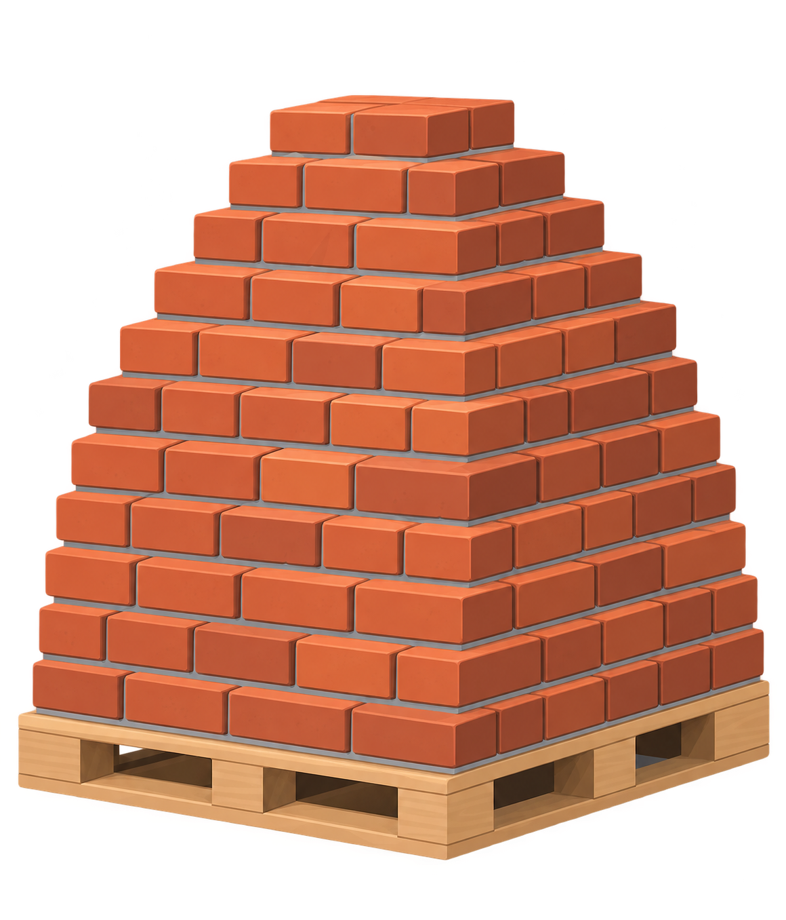
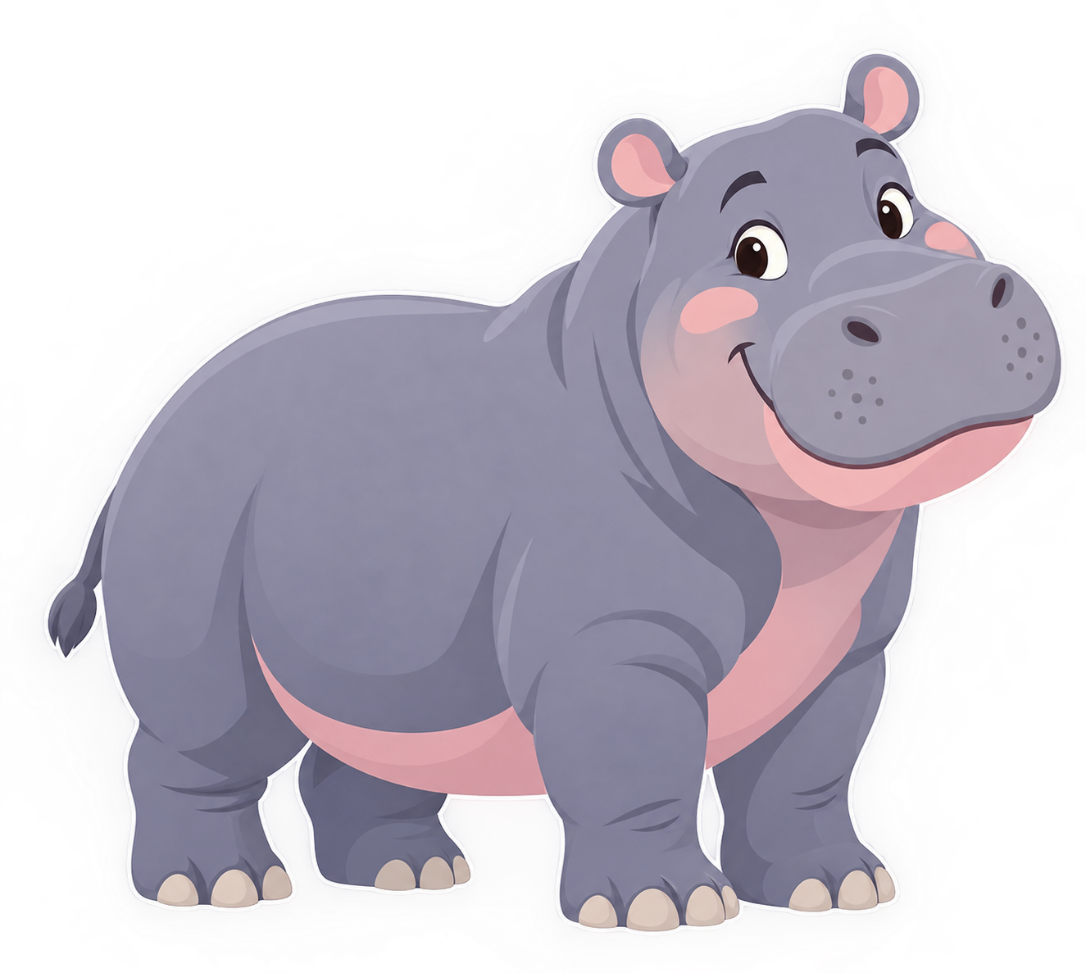
Nurses lift an average of 1.8 tons every shift
Think about this the next time you choose not to use the lift. 1.8 tons is about the same as...
576,000
pennies
549
bricks
1
hippo!
In what other industry would it be acceptable to lift 1.8 tons, day in and day out?
Notes:
Nurses lift an average of 1.8 tons every shift, about 3,600 lb.
Think about this the next time you choose not to use the lift. That's about the same as:
- 576,000 pennies
- 549 bricks
- and yes, one hippo!
Such strain over time results in career-ending and life-altering musculoskeletal disorders. In what other industry would it be permissible to lift 1.8 tons day in and day out? Why should nursing be any different?

Slide 6
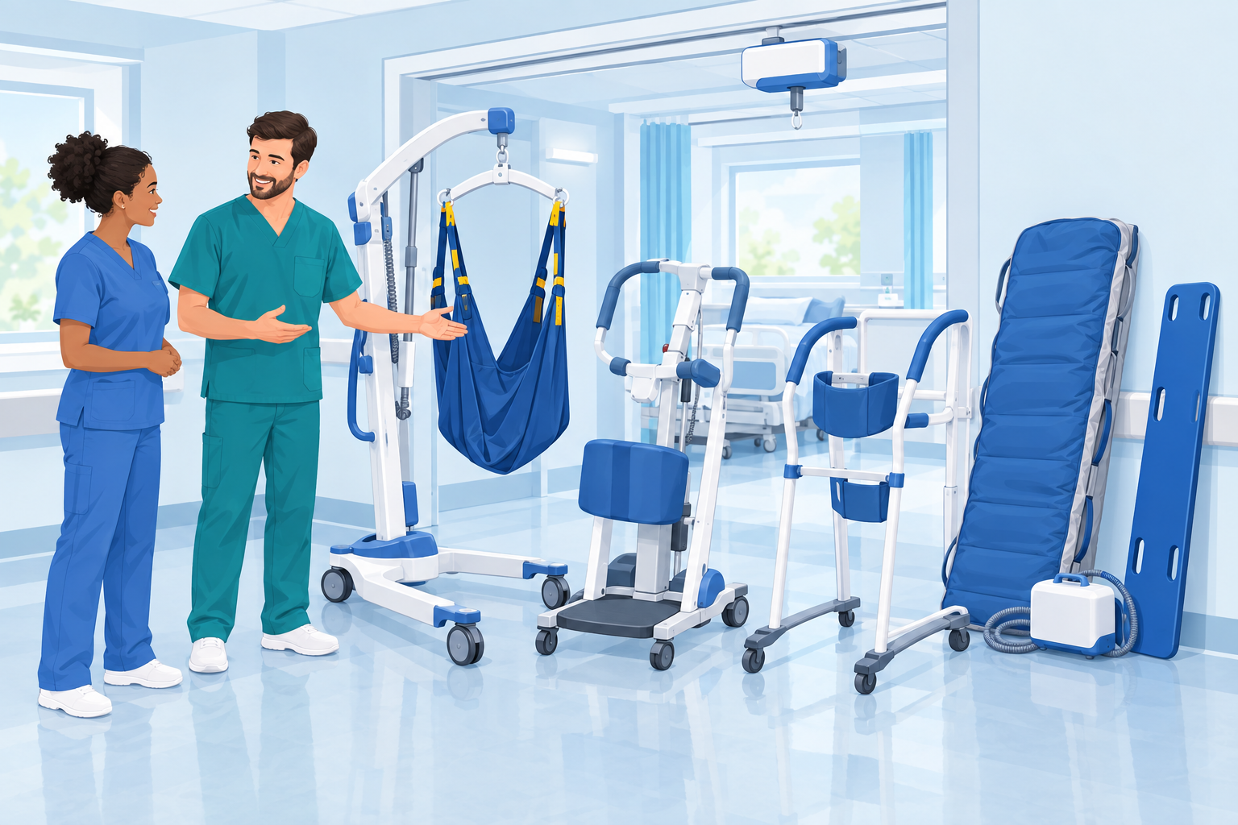
An expectation, all day, every day
Using equipment is like gloving and washing your hands.
It's not a suggestion. It's the standard of care for you and your patients.
✓
Gloves
Every time, for every patient.
✓
Hand hygiene
Before and after every contact.
✓
Lift equipment
For every lift, transfer and reposition over 35 lb.
Notes:
Why should nursing be any different? It shouldn't.
Using equipment is like gloving and washing your hands. It isn't a mere suggestion. It's an expectation, all day, every day.
You'd never skip hand hygiene because you were busy. Treat the lift the same way: for every lift, transfer and reposition above 35 lb of patient weight.

Slide 7
Solutions by dependency level
PATIENT'S LEVEL
USE THIS EQUIPMENT
Totally dependent
Full-sling mechanical lift
1
Extensive assistance
Full-sling lift or stand-assist lift
2
Lifting from the floor (dependent)
Full-sling mechanical lift, with enough help
3
Limited assistance
Stand-assist lift and friction-reducing device
4
Notes:
Match the equipment to how much help the patient needs:
1. Totally dependent patient: full-sling mechanical lift (ceiling lift or floor lift).
2. Extensive assistance: full-sling lift, or a stand-assist lift if the patient can bear weight.
3. Lifting a dependent patient from the floor: full-sling mechanical lift, and make sure you have enough help.
4. Limited assistance: stand-assist lift, plus a friction-reducing device for repositioning.
When in doubt, ask your Unit Peer Leader, or choose the option with more support.

Slide 8
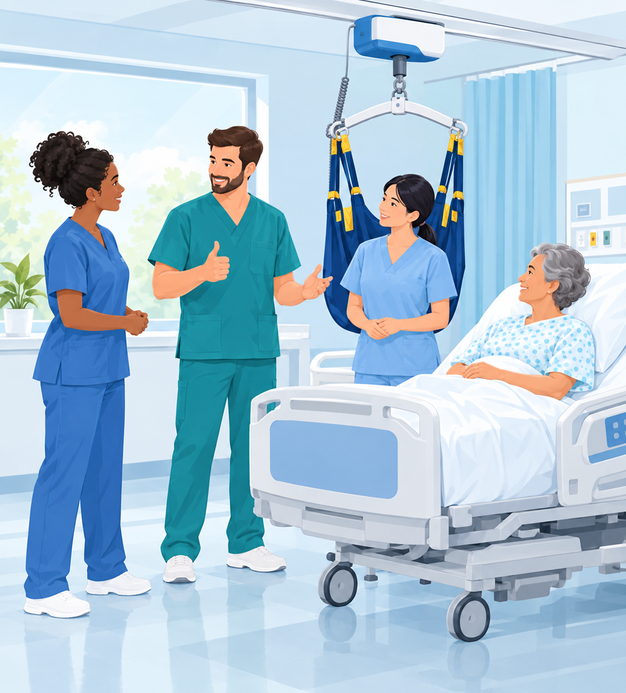
Prevent injuries to yourself and your patients
1
Know your Unit Peer Leaders
They are your on-unit SPHM experts. Find them early.
2
Use the lift equipment
Every lift, transfer and reposition above 35 lb.
3
Ask for help
Get enough people before you start the move.
Notes:
Three habits prevent injuries to yourself and your patients:
1. Know your Unit Peer Leaders. Every unit has them. They're your go-to experts for equipment questions and hands-on help.
2. Use the lift equipment, every time.
3. Ask for help. Get enough people before you start the move, not halfway through.

Slide 9
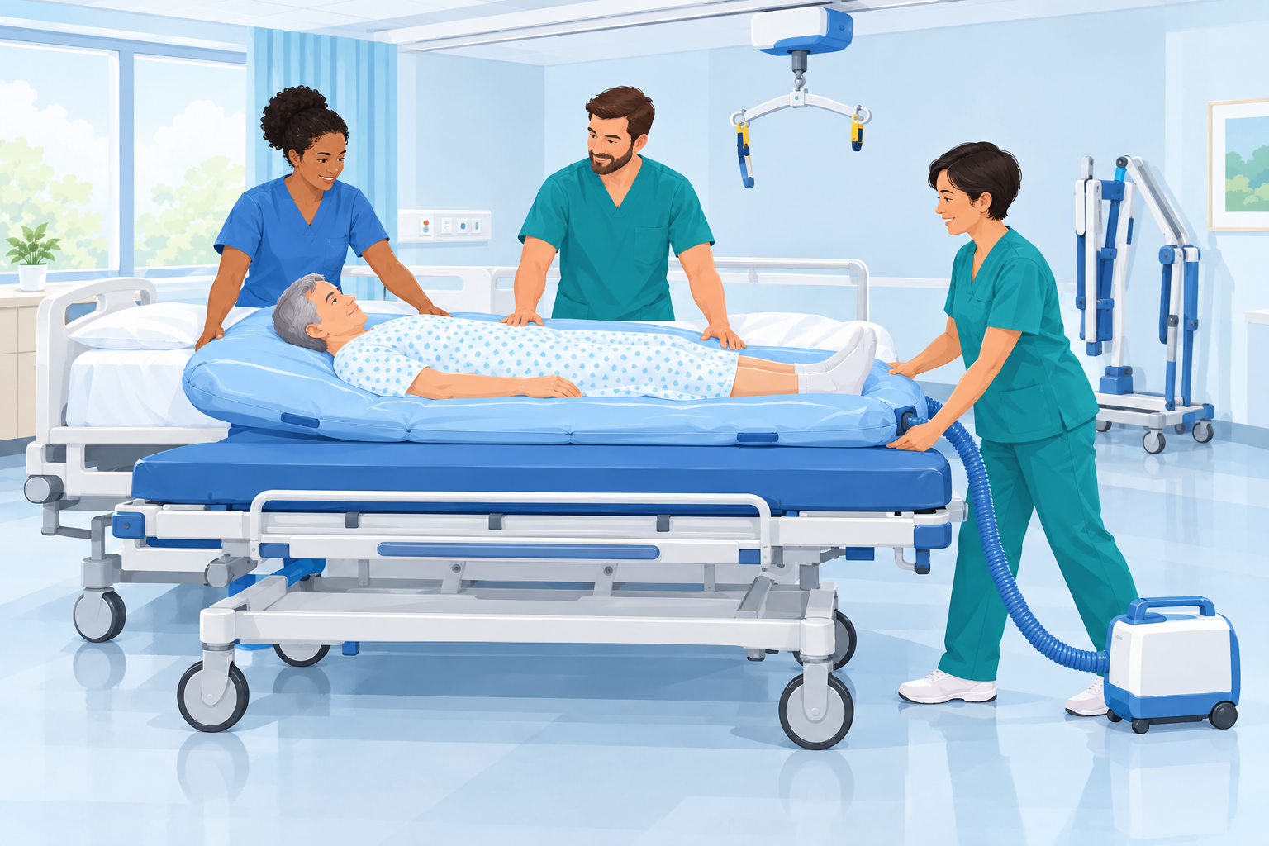
SPHM at VA Central California
✓
A designated SPHM program
Led by the SPHM Program Manager.
✓
Unit Peer Leaders on every unit
Your on-unit experts and trainers.
✓
Ask for help and use the equipment
Every lift, every time.
EQUIPMENT YOU'LL FIND ON YOUR UNIT
Ceiling lifts
Sara lifts
Maxi lifts
HoverJack
HoverMatt
Roll boards
Stand aids
Notes:
Here at VA Central California:
- We have a designated SPHM program.
- Unit Peer Leaders are on each unit.
- Lifting equipment is available, including ceiling lifts, Sara lifts, Maxi lifts, HoverJacks and HoverMatts, roll boards and stand aids.
Remember to ask for help and use the lifting equipment.

Slide 10

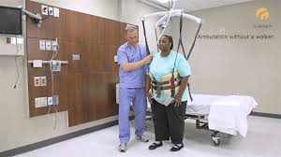
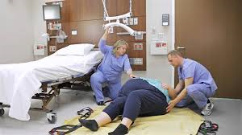
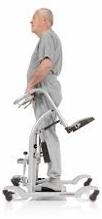
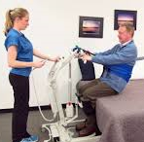
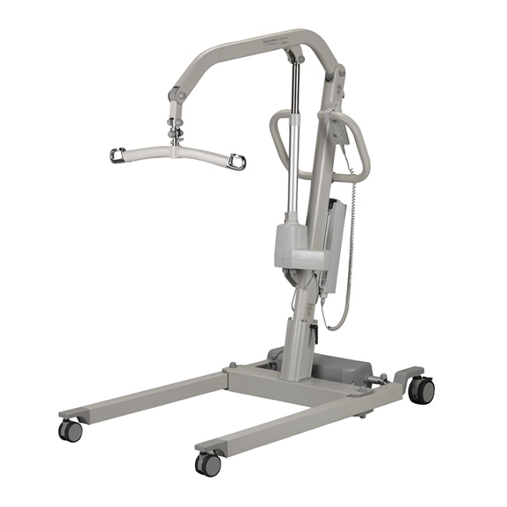
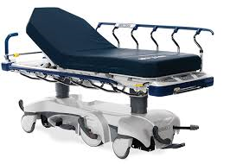
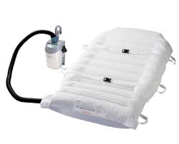
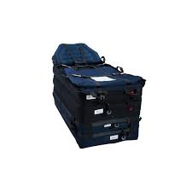
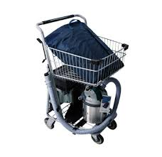
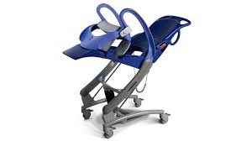
Notes:
Doesn't this look better?
Compare these pictures with the injuries we just talked about. With the right equipment (ceiling lifts, floor lifts, stand-assist lifts, air-assisted transfer devices and slings), staff stay upright and the equipment does the work. Patients are safer and more comfortable too.

Slide 11
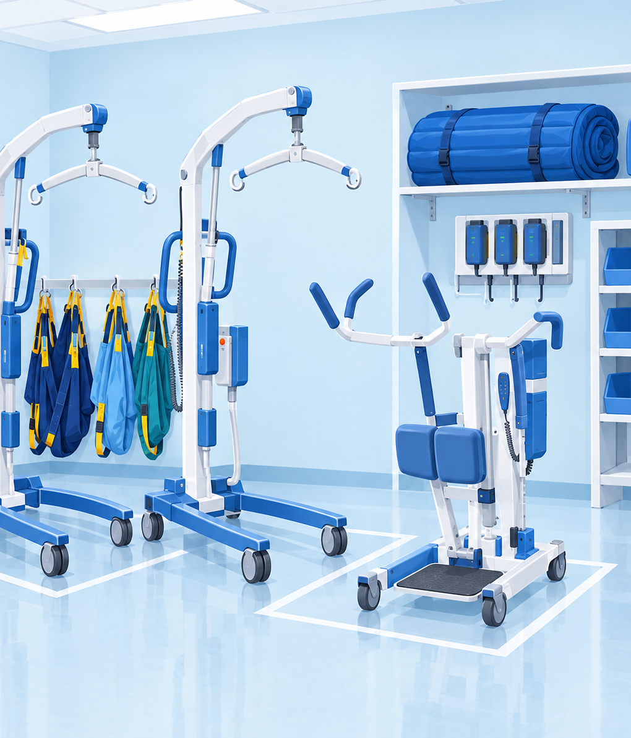
Safe patient handling equipment
The lifts and transfer devices you'll use here, with a short video for each.
Notes:
Next, the equipment. Each device has a short manufacturer video, so you'll see it in action.
Your Unit Peer Leaders will give you hands-on training on the equipment on your unit.

Slide 12
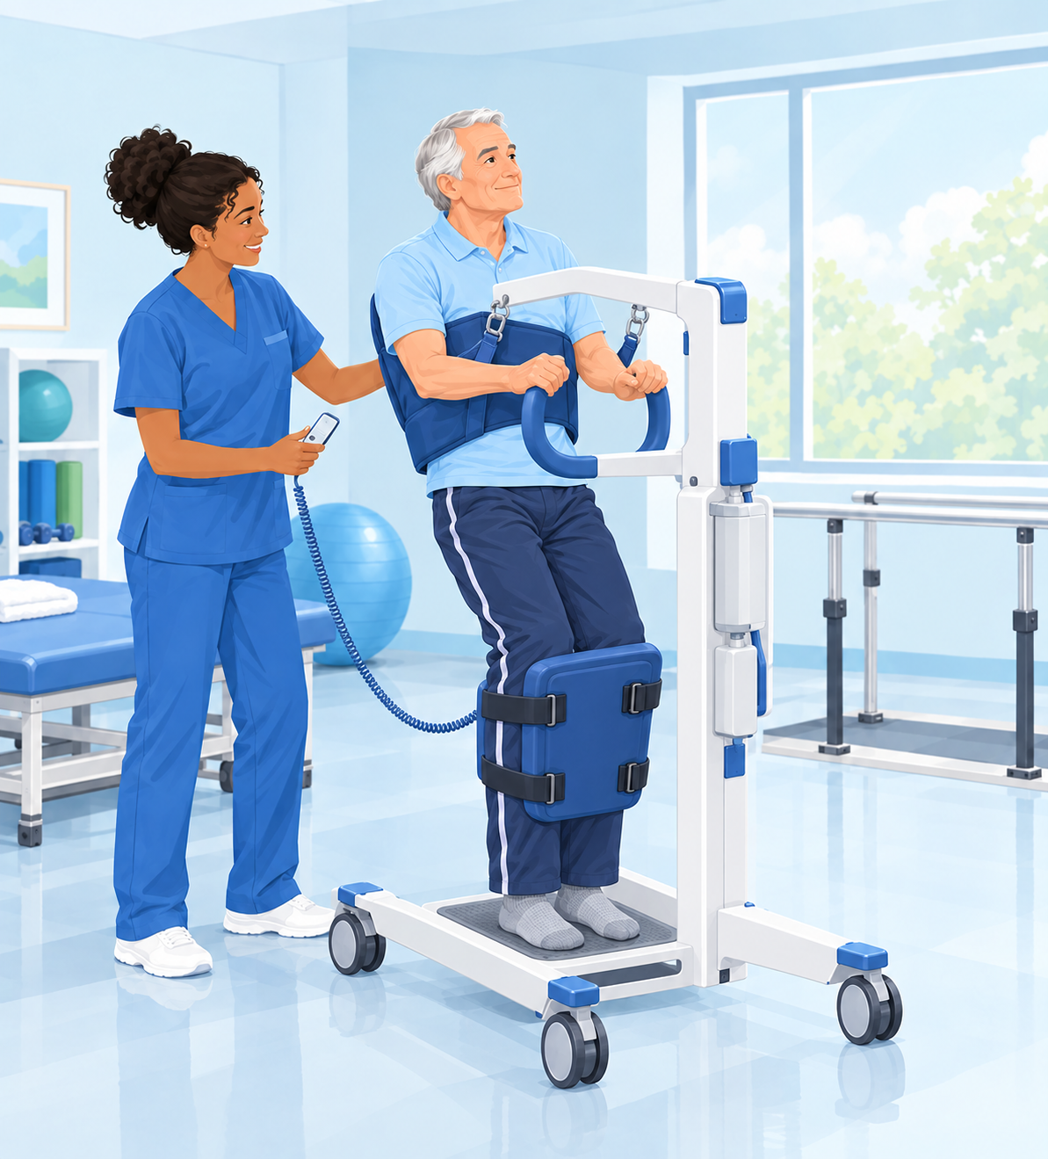
ARJO Sara 3000
Powered stand-assist lift
For patients who can bear some weight and need help to stand: sit-to-stand transfers, toileting and short repositioning moves.
Use it for: extensive or limited assistance (see the dependency chart).
▶ Watch: Sara 3000 (3:35)
Notes:
The ARJO Sara 3000 is a powered stand-assist (sit-to-stand) lift. It's for patients who can bear some weight and need help to stand: sit-to-stand transfers, toileting and short repositioning moves.
Video: https://youtu.be/lTtYo0gv-0c (Sara 3000, 3:35). The Sara Stedy video runs 4:35.
The next slide has the embedded video.

Slide 13
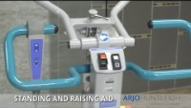
Video: ARJO Sara 3000 stand-assist lift
If the video doesn't play: https://youtu.be/lTtYo0gv-0c
Notes:
[PLAY VIDEO: Sara 3000, about 3:35]
Watch for: how the patient is positioned, how the leg and trunk supports are applied, and how the lift raises the patient to standing.
Backup link: https://youtu.be/lTtYo0gv-0c

Slide 14
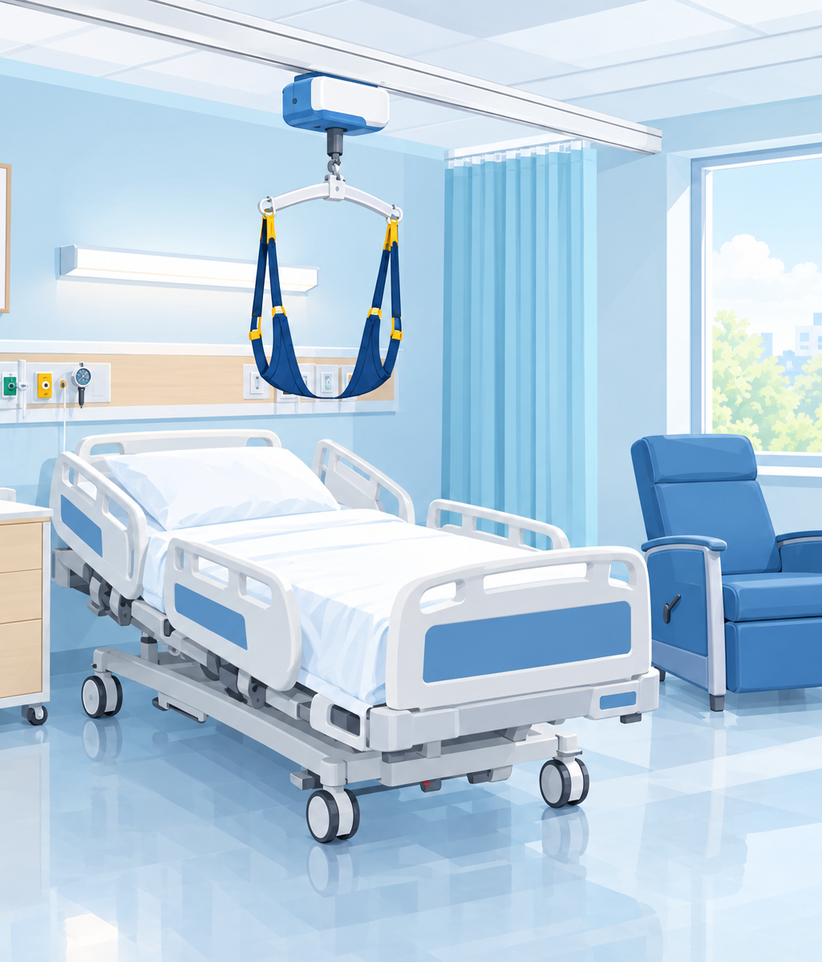
ARJO Maxi Sky 600 ceiling lift
Ceiling lift installation began in 2008
Goal: ceiling lift coverage for 100% of inpatient beds.
We keep expanding the SPHM program through new equipment and training. Your Unit Peer Leader is your expert: find them, and use them to improve SPHM in your work area.
▶ Watch: Maxi Sky 600 (3:47)
VACCHCS will be replacing ~104 overhead ceiling lifts with ARJO Maxi Sky2 600 & 1000 with construction beginning in FY27 Q2; this will include the highly anticipated enhanced charging system (ECS); aka “inline charging.” This means the lift does not have to return to a home charging base: it charges anywhere along the rail.
Notes:
The ARJO Maxi Sky 600 is our ceiling lift.
Ceiling lift installation started here in 2008, with the goal of ceiling lift coverage for 100% of inpatient beds. We're continually expanding the SPHM program through equipment procurement and training.
Your Unit Peer Leader is your expert. Find them, and use them to improve SPHM in your work area.
Video: https://youtu.be/4yJVH2rnehM (3:47). The next slide has the embedded video.

Slide 15
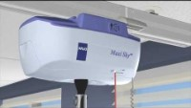
Video: ARJO Maxi Sky 600 ceiling lift
If the video doesn't play: https://youtu.be/4yJVH2rnehM
Notes:
[PLAY VIDEO: Maxi Sky 600, about 3:47]
Watch for: choosing and applying the sling, attaching it to the spreader bar, and using the hand control.
Backup link: https://youtu.be/4yJVH2rnehM

Slide 16
WY'East Denali 600 mobile lift
A great all-around floor lift
Use it in place of a ceiling lift when the room doesn't have one, or when a work order has been placed to repair it.
▶ Watch: Denali 600 (3:22)
Notes:
The WY'East Denali 600 is a power-driven mobile floor lift. It's a great all-around lift, used in place of a ceiling lift if the room doesn't have one, or if a work order has been placed for repair.
Video: https://youtu.be/kh2KM0ooxIY (3:22). The next slide has the embedded video.

Slide 17
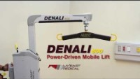
Video: WY'East Denali 600 mobile lift
If the video doesn't play: https://youtu.be/kh2KM0ooxIY
Notes:
[PLAY VIDEO: Denali 600, about 3:22]
Watch for: positioning the base, locking and unlocking the wheels, and attaching the sling.
Backup link: https://youtu.be/kh2KM0ooxIY

Slide 18
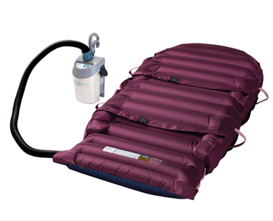
HoverMatt air-assisted transfer
Air-assisted lateral transfer
A cushion of air under the patient cuts the force needed for bed-to-stretcher transfers and boosting up in bed.
▶ Watch: HoverMatt
Notes:
The HoverMatt is an air-assisted lateral transfer device. Air flows through the mattress so the patient floats on a cushion of air, which greatly reduces the force needed for lateral transfers (bed to stretcher) and for boosting up in bed.
Video: https://youtu.be/fTBAI7H9-Eg. The next slide has the embedded video.

Slide 19
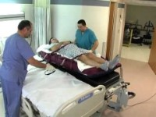
Video: HoverMatt air-assisted transfer
If the video doesn't play: https://youtu.be/fTBAI7H9-Eg
Notes:
[PLAY VIDEO: HoverMatt]
Watch for: placing the mattress, connecting the air supply, and the number of staff needed for a lateral transfer.
Backup link: https://youtu.be/fTBAI7H9-Eg

Slide 20
Resources
1
2
3
VHA Patient Safety Center
visn8.med.va.gov ↗
American Nurses Association
nursingworld.org ↗
OSHA: ergonomics
osha.gov ↗
Your best resource is on your unit
Your Unit Peer Leaders and the SPHM Program Manager can help with equipment, training and patient assessments.
Notes:
Resources for more information:
- VHA Patient Safety Center
- American Nurses Association, occupational safety and health
- OSHA, ergonomics
And your best resource is on your unit: your Unit Peer Leaders, and me, your SPHM Program Manager.

Slide 21
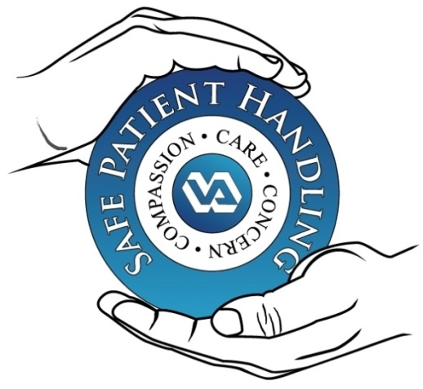
Thank you!
Welcome to VA Central California Health Care System
Daniel Agbogidi, BSN, RN
Safe Patient Handling & Mobility Program Manager
Compassion · Care · Concern
Notes:
Thank you, and welcome to VA Central California Health Care System.
Remember:
- Don't manually lift more than 35 lb of patient weight. Use the equipment.
- Match the equipment to the patient's dependency level.
- Know your Unit Peer Leaders, use the lift, and ask for help.
Questions? Contact me, Daniel Agbogidi, your SPHM Program Manager.

